Slide 1
Burrows-Wheeler transform and FM index
Aleksandar Mršić, Luka Lončar

Slide 2
What is Burrows-Wheeler Transform?
Reversible permutation of characters of a string, used originally for compression and useful for fast searching substrings
There are a few steps:
Define a string we want to compress and optionally add a dollar sign as a end of string character
Do all of the permutations for that string
Sort the permutations by alphabetical order
Take the last column of the sorted permutations to get the BWT string

Slide 3

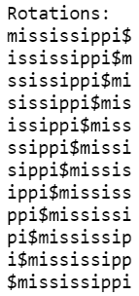
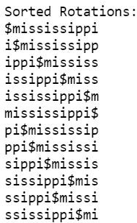

Example “mississippi”

Slide 4

Compression
The same characters tend to appear in runs or very close to previous occurrences. In the following example we will demonstrate this
As we can see there are recurring letters and can be compressed. The highlighted part of this string would compress to “2B2b5eah2ih5tu”

Slide 5
Problem?
But there is a problem with this way of computing the BWT - storing all the permutations and sorting them consumes too much memory and is impossible with very big files
Example: 1 file size 150MB with 2 million characters. There are at least 2 million permutations and we get 2 million * 150 MB = too much memory

Slide 6
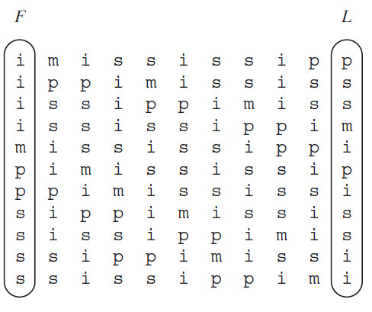
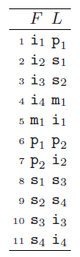
Optimization FM Index
An index combined with BWT with a few more data structures:
F and L columns which are the core of the BWT structure
Tally data structure with checkpoints
SA data structure with checkpoints

Slide 7
FM Index: querying
P=isi
P=isi
If we are only storing the F and L columns how to query substrings?

Slide 8
FM Index: querying
P=isi
P=isi

Slide 9
FM Index: querying
P=isi
What is a problem with this method?
Scanning through the set of potential next characters is not efficient as it could be - O(n)
That is a problem that can be solved using a Tally data structure
O(n)

Slide 10
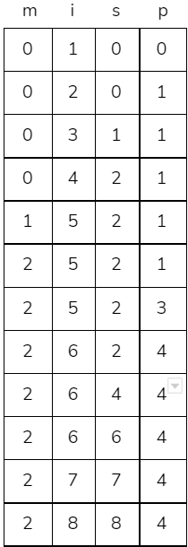
FM Index: Tally structure
How many “i” characters occurred before the highlighted group?
Requires 1 lookup in the row above
This method is fast O(1), but memory consuming which is solved using checkpoints

Slide 11
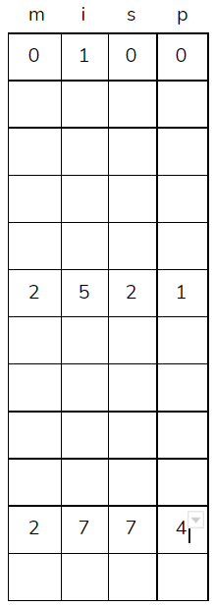


FM Index: Tally with Checkpoint
If we store, for example, every x row we get less memory consumption and in the worst case O(x)
Checkpoint values = {8, 32, 128, 512}

Slide 12

FM Index: Suffix Array
SA
How to solve the offset problem?
Adding a Suffix Array with checkpoints
Checkpoint values = {4, 16, 128, 512}

Slide 13
Results
Algorithm used in optimized bwt for this project is SAIS
SAIS provides an implementation of the induced sorting based suffix array construction algorithm
The algorithm runs in O(n) worst-case time, and MAX(2n, 4k) worst-case extra working space, where n and k are the length of the input string and the number of alphabets.
Implementation is in C language

Slide 14
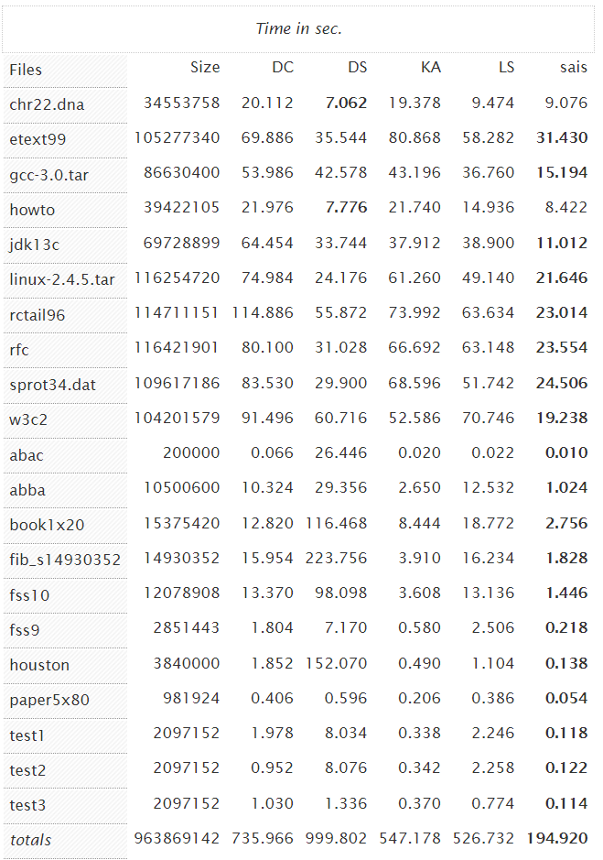
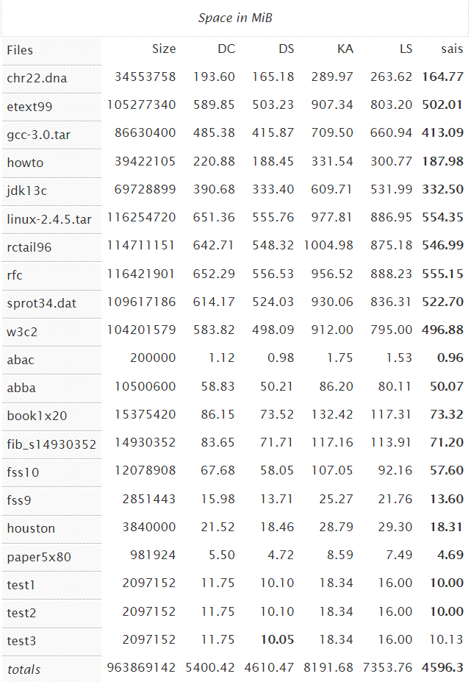

Slide 15
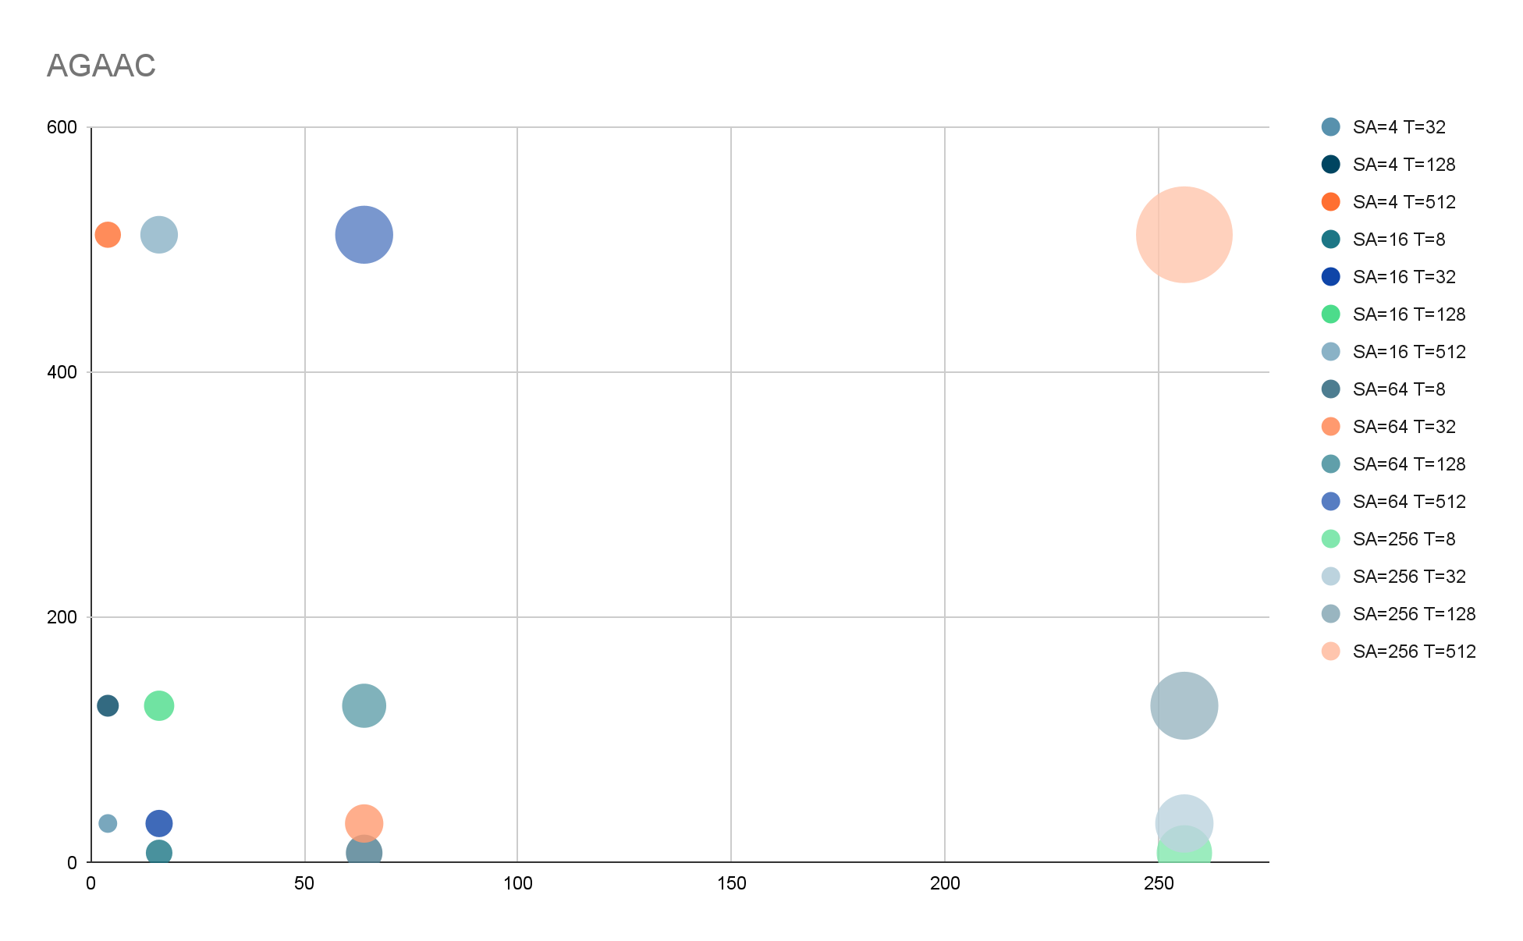
Common Carp search time
Non optimized: BWT = 32,327s AGAAC: 2,548ms (3966) TCAAATC: 1,309ms (2490) TAACATCCAG: ~0ms (39)

Slide 16
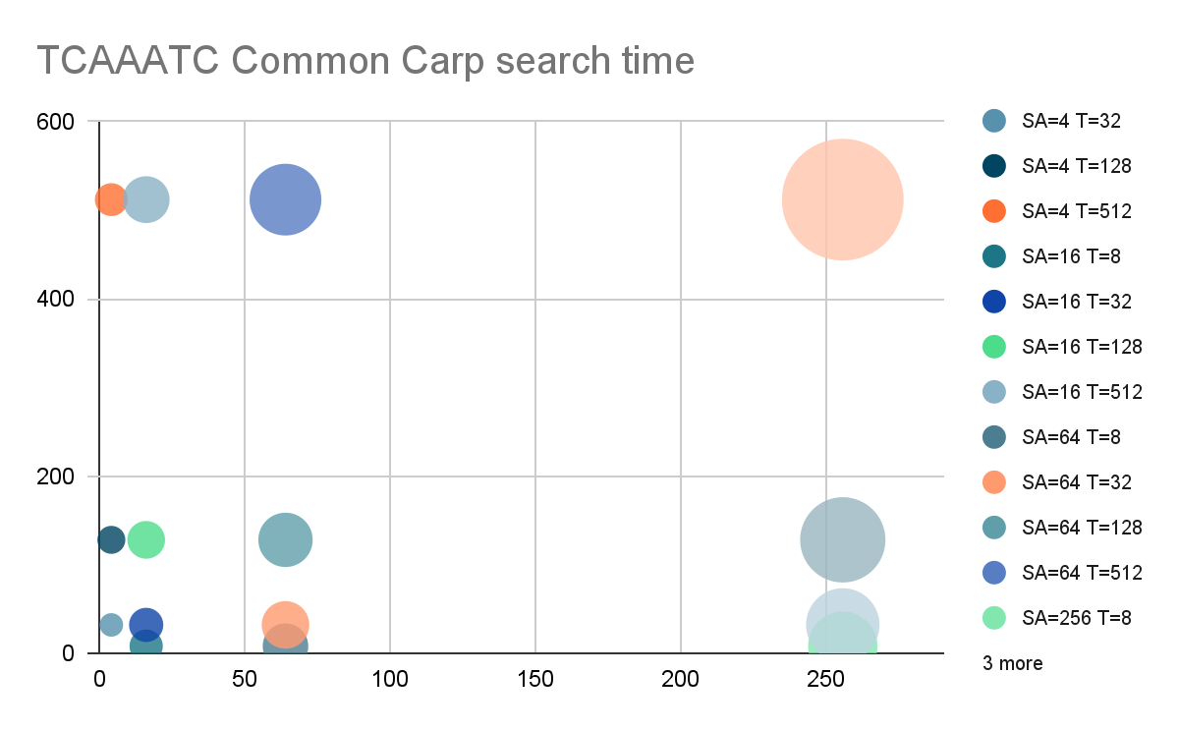

Slide 17
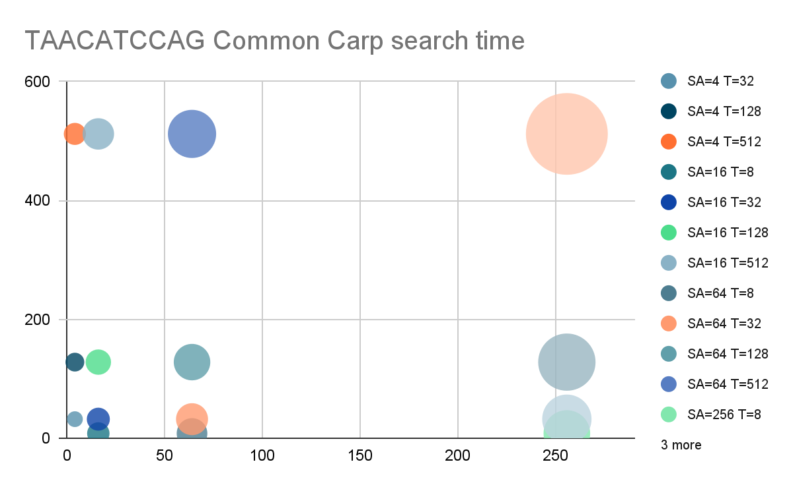

Slide 18
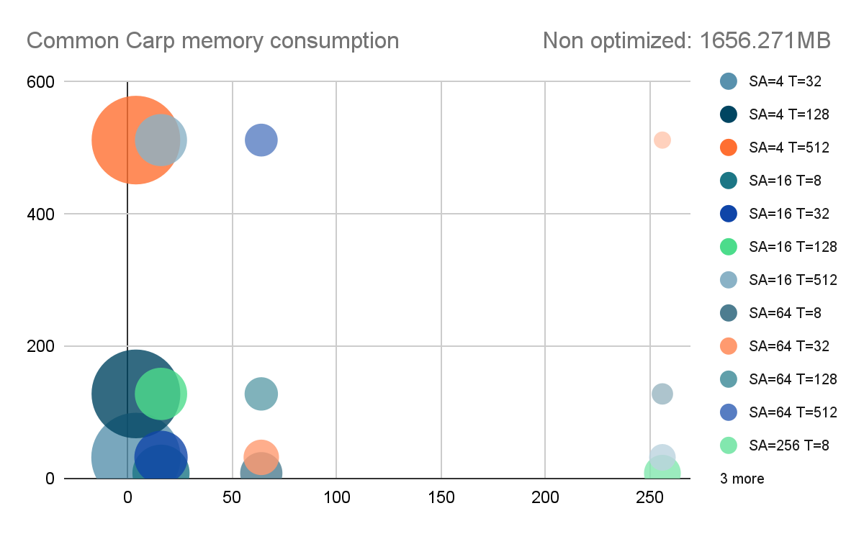

Slide 19

Coffea Arabica search time
Non optimized: BWT = 77,292s ATGCATG: 3,251ms (6529) TCTCTCTA: 0,643ms (1262) TTCACTACTCTCA: ~0ms (0)

Slide 20


Slide 21
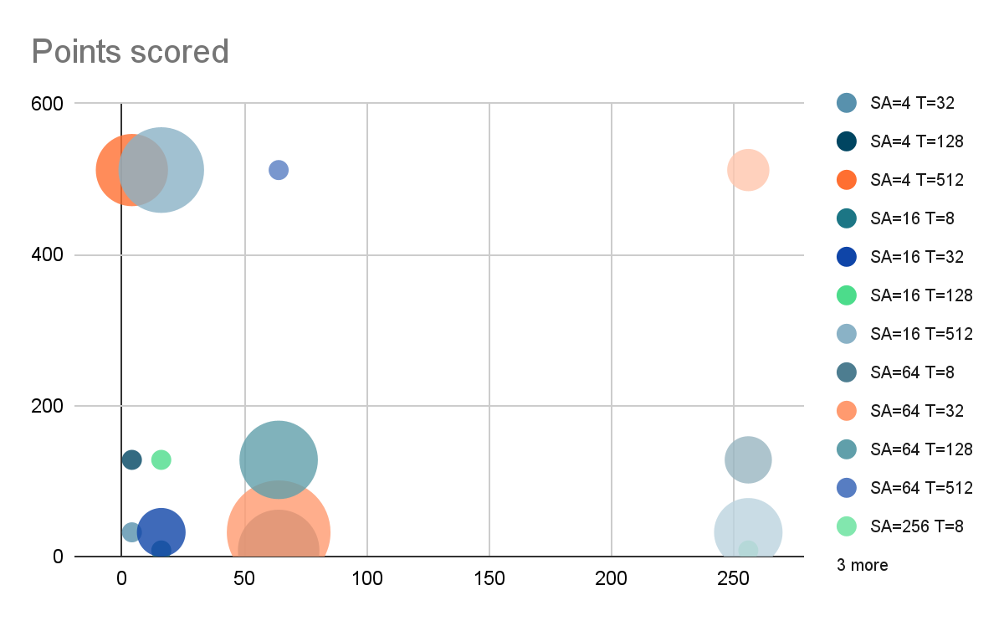

Slide 22
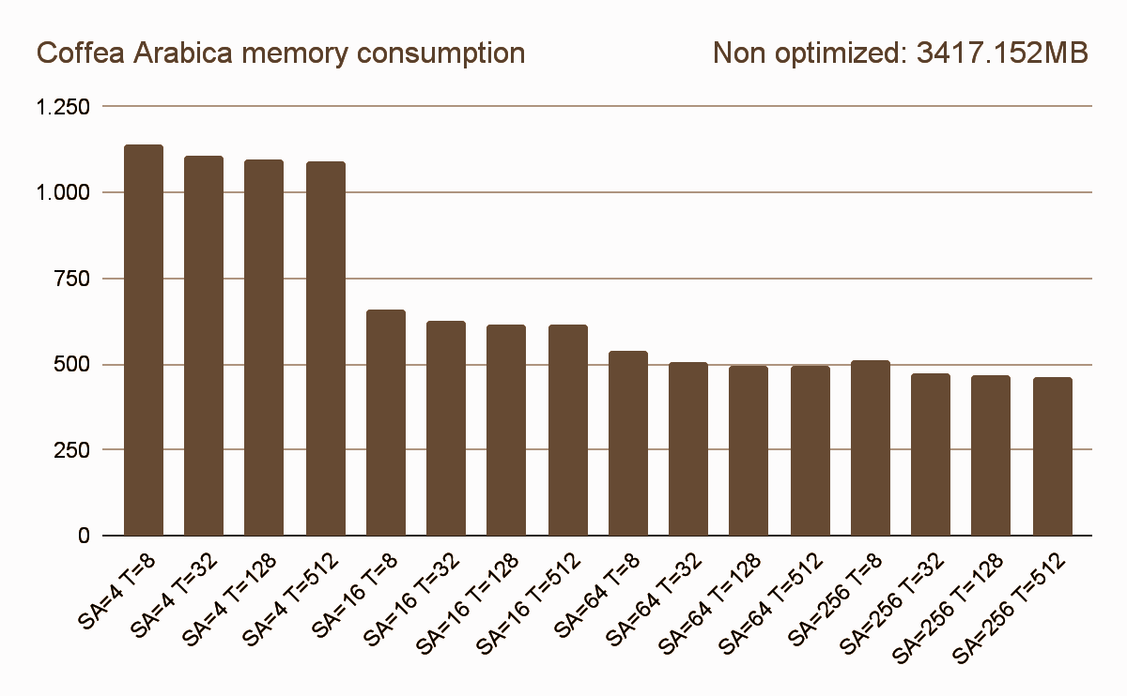

Slide 23
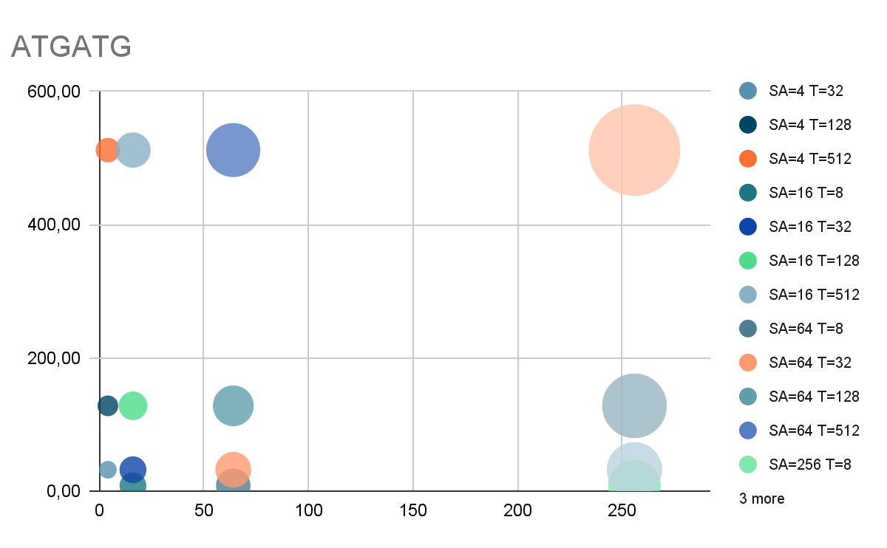
Mus Pahari search time
Non optimized: BWT = 222,536s ATGCATG: 23,436ms (43200) CTCTCTA: 6,211ms (10237) TCACTACTCTCA: ~0ms (8)

Slide 24


Slide 25
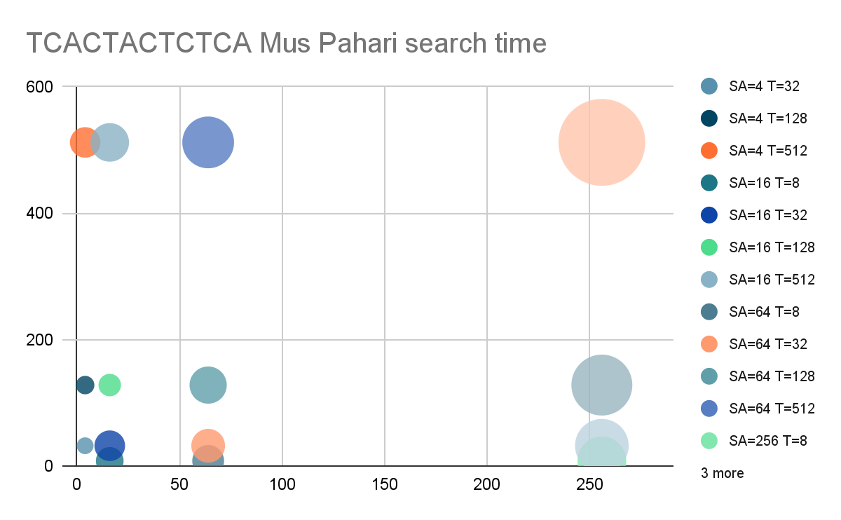

Slide 26
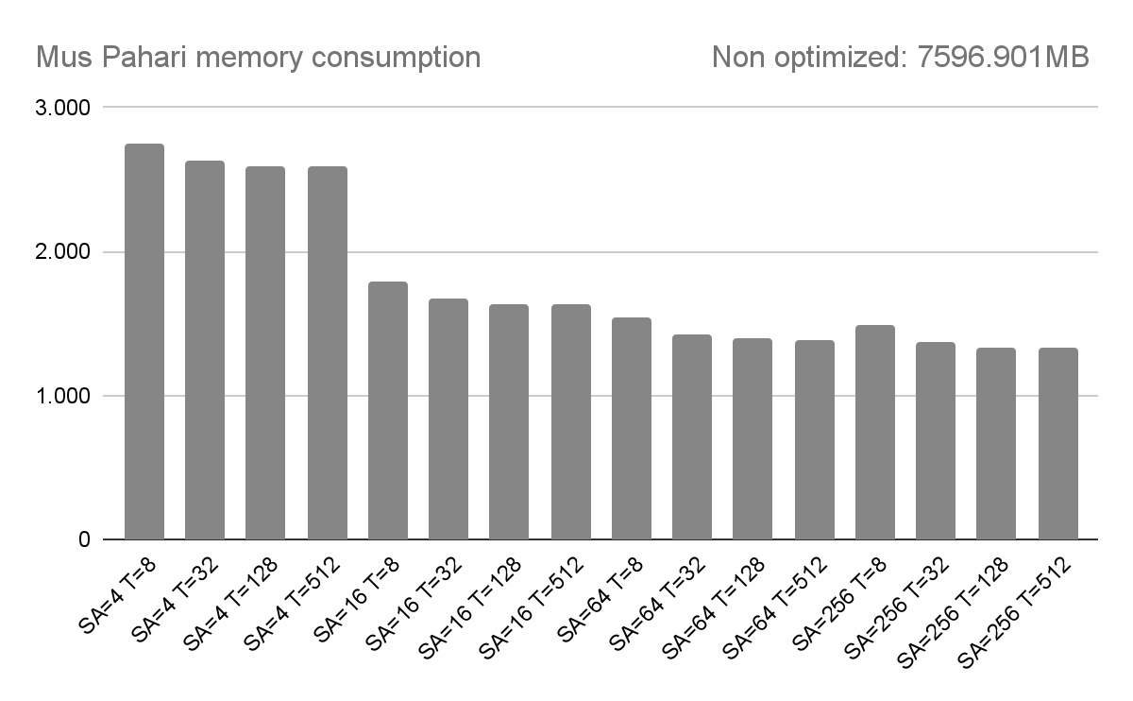

Slide 27
Thank you for your attention
Link to the Git repository

